Slide 1
William Zhang, Andy Gao, Srini Kasturi
World Bank Group's Cloud Journey with DevSecOps

Slide 2
World Bank Group's Cloud Journey with DevSecOps

Slide 3


Slide 4


End Extreme Poverty
Reduce the percentage of people living on less than $1.90 a day to 3% by 2030
Boost Shared Prosperity
Foster income growth of the bottom 40% of the population in every developing country
Ending Extreme Poverty and Promoting Shared Prosperity in a Sustainable Manner
Information and Technology Solutions

Slide 5








World Bank Group’s Journey to the Cloud

Slide 6
Traditional Approach to Security
SDLC Phases:
Gather requirements
Security requirements
Architecture & design
Security architecture
Develop software
Test software
Security testing
Remediation
“Security fix can cost you more $$$$”
Waterfall model, with security testing
at the end

Slide 7
Traditional Approach – Project Phases
Inception
Elaboration
Construction
Transition
Operation
Requirements
Secure Design
Secure Build
Secure Testing
Vulnerability Mgmt.
Governance approvals
Project Data Sheet
Project Risk Profile
Business Requirements
High Level Design
Data Model
Low Level Design
Traceability Matrix (RTM)
Project Test Plan and Results
Security Scan Results
Testing environment
Additional docs
Accreditation Decision
Input
Project Tiering Questionnaire
Determine resiliency requirements
Threat Modeling
Security Architecture Design Review
Verify Security Requirements & Controls
Develop Security Test Plans
System Certification & Accreditation
Periodic Vulnerability assessments and management
Incident Response
Resiliency exercises
Activity
Project Risk-Tiering
Security Objectives
Resiliency requirements
Threat Model
Security Requirements
Security Architecture
Security Controls
Risk-based Security Test Plan
Test Results
Accreditation & Business Unit Signoff
Scan reports
Risk identification and mitigation
Software vulnerability intelligence
Deliverables
Security
Architecture
Certification &
Accreditation
Vulnerability
Management

Slide 8
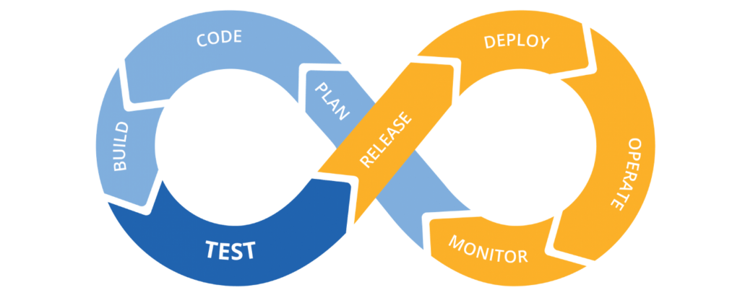
Traditional Approach ~Worked, Until …
Instead of months and weeks, business wants changes to happen in days and hours.

Slide 9
Our Agile Approach to Security – Act I
Automate Security Testing Steps
Code
Test
Automate manual & repetitive testing
Address speed vs scalability vs quality
Streamline end-to-end testing
Faster accreditation
Release
“Build mutual trust & confidence with automation”

Slide 10
Our Agile Approach to Security – Act I
"DevSecOps" paved our way to automate cloud security testing
Automation Approach:
Phased implementation
Codify per service (AWS, Azure)
Codify key controls (Risk based)
Integrate automation with DevOps pipeline
Automated decision gates (approve/reject)

Slide 11
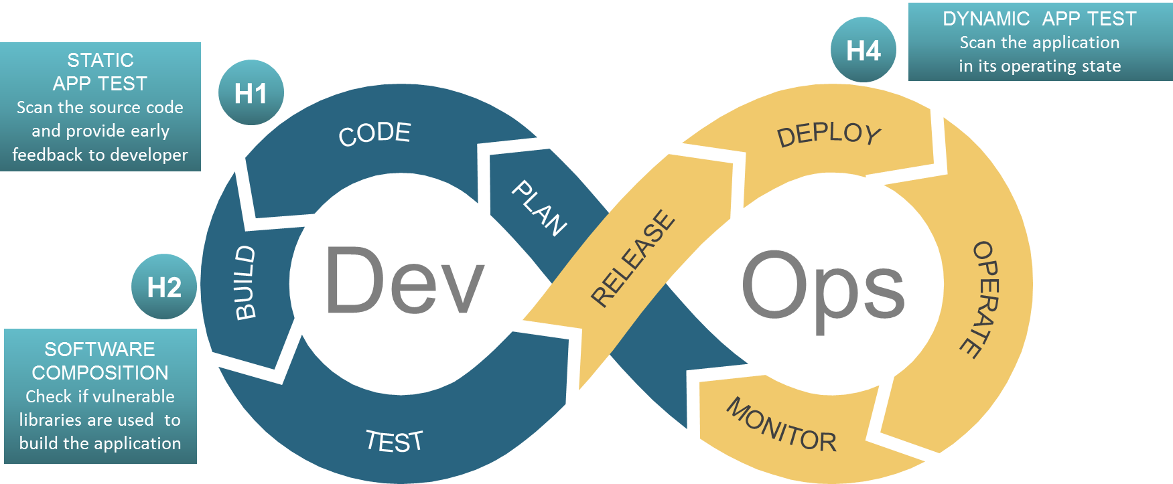
DevSecOps –Initial Set of Security Hooks

Slide 12
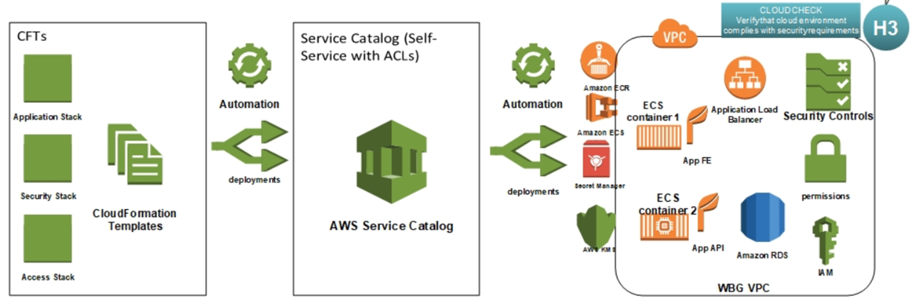
Our Agile Approach to Security – Act II
Infrastructure-as-Code with Built-in Security

Slide 13
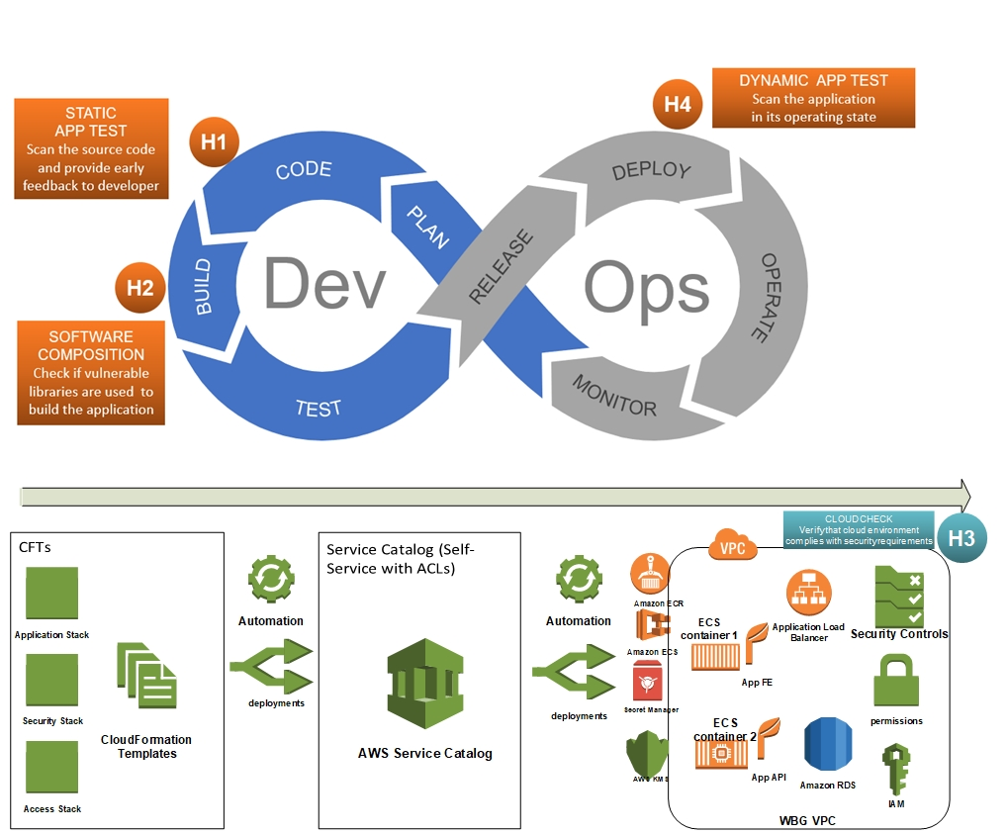
Our Agile Approach to Security – Acts I & II Together
DevSecOps Pipeline with Security for Both Application & Infrastructure
Security-as-Code is about codifying security controls, and building controls verification into DevSecOps tools and practices
Codify the security controls into infrastructure-as-code templates (AWS CloudFormation, Azure ARM template and etc.)
Embed security controls checks into (CI/CD) pipelines
Embed security checks into ongoing monitoring and testing

Slide 14
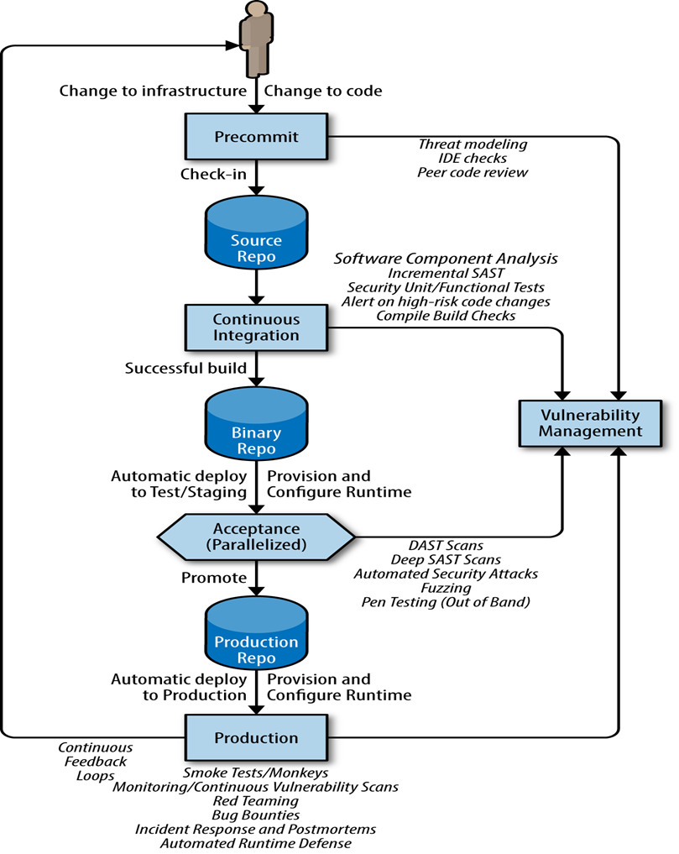
Pipeline-enabled SDLC – Secure Agile Delivery
Agility with security safeguards:
Changes to application code or infrastructure specification are automatically validated with security checks/tests/gates without introducing unnecessary delays.
Health of VM and container images are validated off line so that there is less delay for the pipeline
The use of code library is validated inline within the pipeline for vulnerabilities before application deployment
DevSecOps Hook
DevSecOps Hook
DevSecOps Hook
DevSecOps Hook
DevSecOps Hook
Notes:
Developer community starts to get addicted to DevOps.

Slide 15
Our Agile Approach to Security – Next Acts
Pipeline-as-Code
Security-as-code for SaaS platforms
Additional security hooks based on industry best practices
More automation based on emerging technologies
Robotics process automation
Machine learning / Natural Language Processing

Slide 16
